Slide 1


Priyadarshini College of Engineering ,Nagpur Department of Computer Technology Session 2019-20
Project Progress Seminar – 5
On
“Sensing Harmful Gases in Industries using IOT & WSN”
Group Members
Rishikesh Kumar
Twinkle Pandey
Ajinkya Ghadole
Komal Pandey
Samiksha Yerpude
Under The Guidance of Dr. (Mrs.) Nita Thakare
Prof. (Mrs.) Snehal S. Golait HOD,C-Tech

Slide 2
Contents
Introduction.
Literacy Survey.
Proposed Methodology.
Proposed Model.
MQ2 & MQ135 Sensor Output.
6. Hardware & Software Required.
Project Progress Report.
Conclusion.
Reference.

Slide 3
Introduction
Industrial gases are gaseous materials that are emitted out from Industries.
The principal gases are nitrogen, oxygen, carbon dioxide, argon, hydrogen, helium and acetylene; although a huge variety of gases and mixtures are available in gas cylinders. Industrial gases are emitted due to manufacturing of various items and materials that are used in a wide applications Industrial gases are very harmful and have severe impact on anyone or anything exposed to it.
In industry there are many workers working in various units like production, packaging, building, manufacturing etc they are some or the other way exposed to these harmful gases which affects them very badly and sometimes even may cause death. This Industrial business also covers the sale or hire of gas cylinders and associated equipment to tradesmen and occasionally the general public.
Products such as helium-balloons, dispensing gases, welding gases , LPG and medical oxygen-emission also though used widely for some application are harmful.

Slide 4
Currently IIoT i.e. Industrial Internet of Things is widely regarded as to be one of the latest developing trends affecting industrial businesses today and also in the upcoming future.
Significant improvements to safety, efficiency, and profitability etc had been marked for Industries that had IIoT implemented and it is expected that this trend will continue as IIoT technologies are more widely adopted.
Spatially distributed and dedicated sensors which works collectively as a network or collect and process data of cluster is known as Wireless Sensor Nodes(WSN).
It monitors and record the physical conditions of the environment and organized the collected data at a central location. WSNs measures environmental conditions like pollution levels, humidity, temperature, sound, wind, and so on. The WSN is built of nodes which are placed in a network and can be from a few to several hundreds or even thousands, where each node is connected to one (or sometimes several) sensors.

Slide 5
Literature Survey
Base Paper :- Anam Mir, Ajit Kumar Khachane, “Sensing Harmful Gases in Industries using IOT and WSN”, 978- 1-5386-5257-2/18/$31.00 c 2018 IEEE.
In paper Distributed System as Internet of Things for a new low cost, Air Pollution Wireless Monitoring on Real Time the author has described A low-cost wireless monitoring system is developed to measure CO, CO2 and the density of dust parameters based on a multi-layer distributed model with an Arduino platform, sensors and wireless connectivity Xbee.
The data is collected in computer and send to web page to monitor air pollution on real-time.
The validation of the mentioned concept has been realized in cities Quito, Amagua˜na and Tena of Ecuador.
The system is quite complex since they have used various types of software languages for various purposes (For ex. Java for computer system, C/C++ for conversion of analog data to digital form, etc).
In IOT- Based Air Pollution Monitoring Forecasting System the author explained IOT based
air pollution monitoring and forecasting system consist of a system where environmental sensors including SO2, NO2, CO sensors and Meteorological sensors (wind direction, wind speed, temperature, humidity and air pressure) are installed in some of the monitoring points.
The WSN based air pollution monitoring system its developed on AVR AT-mega-32 Micro-controller as controlling unit of overall system.
Data-set of different sensors parameters like MQ2,MQ5,MQ7,Temperature and Humidity is detected by the Sensor Grid used.

Slide 6
Proposed Methodology
It utilizes IOT and WSN technology to achieve better connectivity and to create good sensing area.
Switching actions will be incorporated in order to achieve multiple observations of the different sensors used.
Different harmful gases CO2,NH3,Benzene,Sulphur Dioxide ,Nitrogen oxide, Carbon Monoxide etc. will be taken into consideration for obtaining optimized data for visualization.
Raspberry-Pi software C.net along with Zigbee module will be used to design IOT gateway.
To sensed various harmful gases present in industrial area,then visualized it on dashboard for taking proper decision to control its contamination in the industrial area so as to ensure healthy working environment for employees working in industry.
In the proposed work, both software and hardware part are included in such a manner that IOT and WSN technology when clubbed with reconfigurability concept will have observing responses throughout all the sensing duration.

Slide 7
Proposed Model

Slide 8
MQ2 & MQ135 Sensor Live
MQ2 Sensor
Gas Sensor(MQ2) module is useful for gas leakage detection (in home and industry).
It is suitable for detecting Alcohol, Benzine, CH4, Hexane, LPG, CO. Due to its high sensitivity and fast response time, measurements can be taken as soon as possible.
The sensitivity of the sensor can be adjusted by using the potentiometer.

Slide 9
MQ135 Sensor
This module has high sensitivity to LPG, iso-butane, propane and LNG.
It can also be used to detect the presence of alcohol, cooking fumes, and cigarette smoke.The module gives out the concentration of the gases as a analog voltage equivalent to the concentration of the gases.
The module also has an onboard comparator for comparing against an adjustable preset value and giving out a digital high or low. It can be easily interfaced with your Arduino or Raspberry Pi.

Slide 10
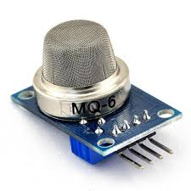
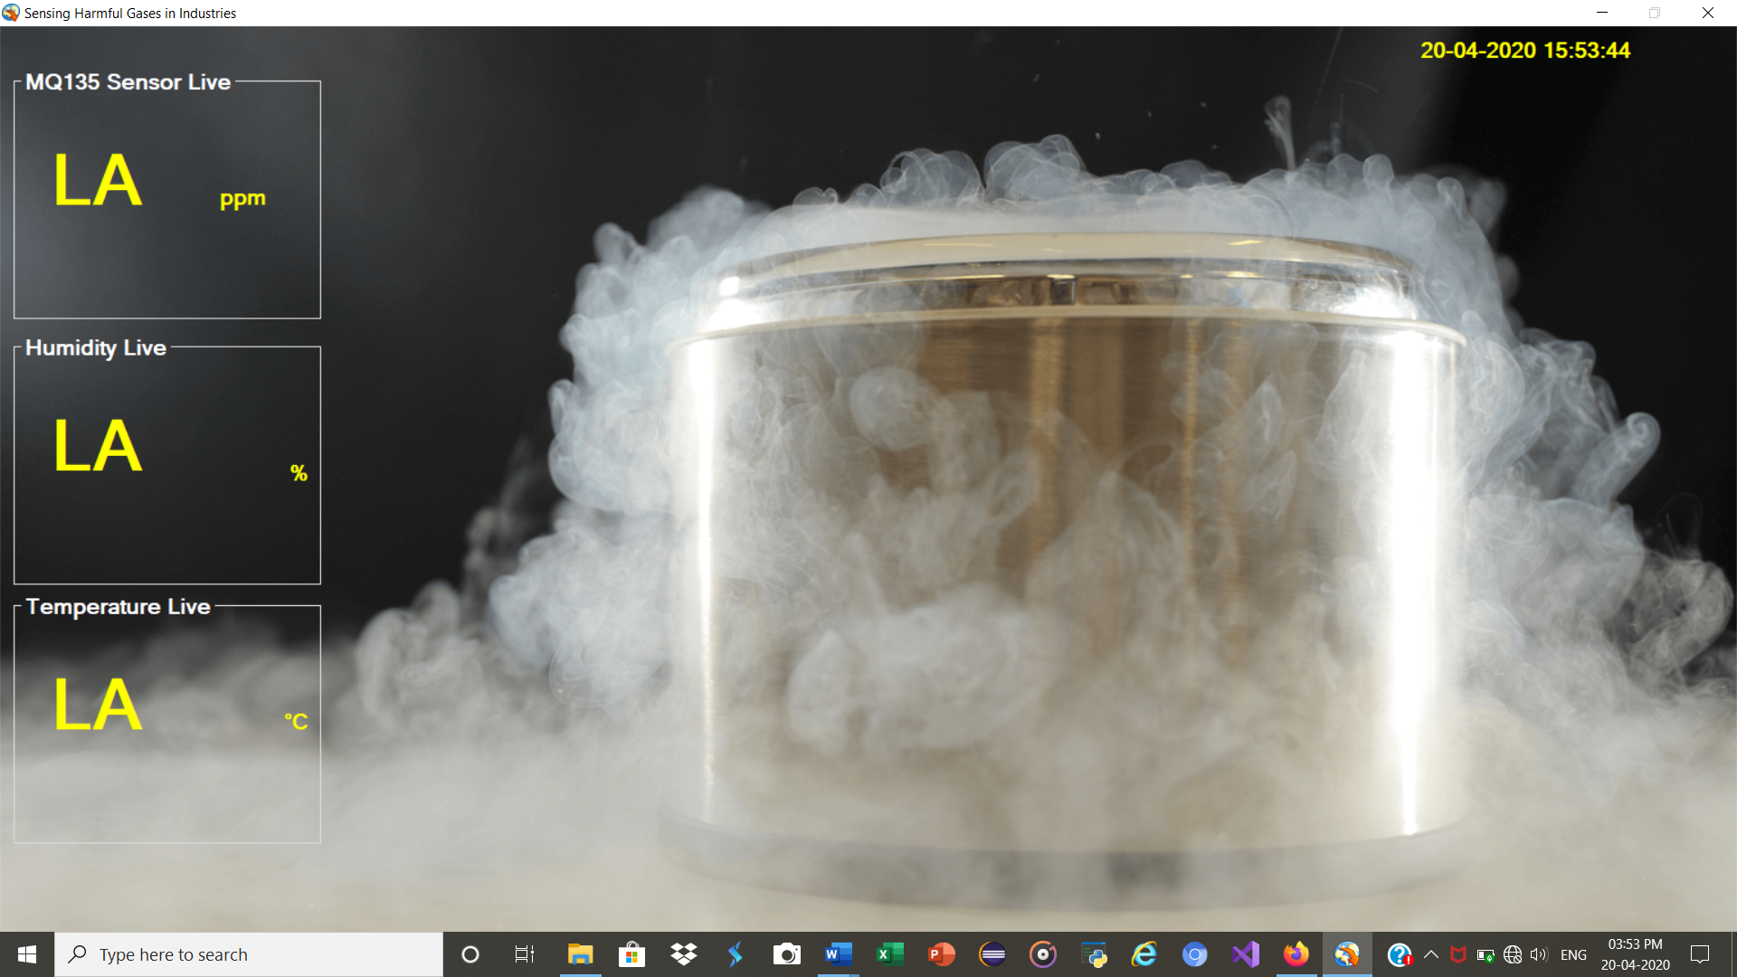
MQ2 And MQ135 OUTPUT
MQ3 Gas Sensor
MQ6 Gas Sensor

Slide 11
Hardware & Software Required
Requirements | Versions
Microsoft Visual Studio | 2014
C.net | 2013
MySQL | 2016
WiFi
Gas sensors (MQ series )
Raspberry pi 4

Slide 12
Project Progress Report - 5
Project Group No. | 20
Project Title | Sensing Harmful Gases in Industries using IOT & WSN.
Progress period | 5-6 months
Report Submission Date | 25/04/20
Section 1: Summary: Industrial gases are emitted due to manufacturing of various items and materials that are used in a wide applications Industrial gases are very harmful and have severe impact on anyone or anything exposed to it. Significant improvements to safety, efficiency, and profitability etc had been marked for Industries that had IIoT implemented and it is expected that this trend will continue as IIoT technologies are more widely adopted. We have fixed the hardware components . We started making software for our project We have completed our software
Section 2: Activities & progress: We searched some research papers from IEEE and from this we get an idea for sensing harmful gases in industries using IOT & WSN. We have installed the software microsoft visual studio and collected the hardware components . We have installed all our software and completed our project.

Slide 13
Section 3: Outputs: The software has been installed and we have tested more 2 of the gas sensors ie MQ3 & MQ6 and got its value.
Section 4: Evaluation: The existing gas sensors are capable of sensing the data, the graphical representation and logging will be carried out simultaneously. On Output screen a highest value is pre-defined if the sensed data exceed this limit then manual buttons for ON/OFF is provided on screen .
Section 5: Risk, Issues & Challenges: In this project we don’t have major challenges but some minor challenges like how many detectors we need and where we will place them & which sensor will be best for the project.

Slide 14
Conclusion
This project is the integrates a Wireless Sensor Network (WSN)-based harmful gases sensing system using different gas sensors and whose sensed data is passed through IOT gateway to server.
In future, this prototype can be extended since in this project X-bee is used which has limited range up to 100m so we can increased the distance by using X-bee Pro up-to km.
Thus we can enhanced the project .

Slide 15
References
Walter Fuertes and Diego Carrera., “Distributed System as Internet of Things for a new low-cost, Air Pollution Wireless Monitoring on Real Time”, IEEE/ACM 19th International Symposium on Distributed Simulation and Real Time Applications, 2015.
Chen Xiaojun, Liu Xianpeng and XuPeng. “IOT- Based Air Pollution Monitoring and Forecasting System.”, International Conference on Computer and Computational Sciences (ICCCS) IEEE, 2015.
Deepak Mehetre and Shwetal Raipure “Wireless Sensor Network Based Pollution Monitoring System in Metropolitan Cities”, ICCSP conference, 2015.
Petros Spachos “Real-Time Indoor Carbon Dioxide Monitoring through Cognitive Wireless Sensor Networks”, 10.1109/JSEN.2479647, IEEE Sensors Journal, 2015
Vikhyat Chaudhry, “Arduair: Air Quality Monitoring”, International Journal of Environmental Engineering and Management.ISSN 2231–1319,2013

Slide 16
THANK YOU

